Slide 1

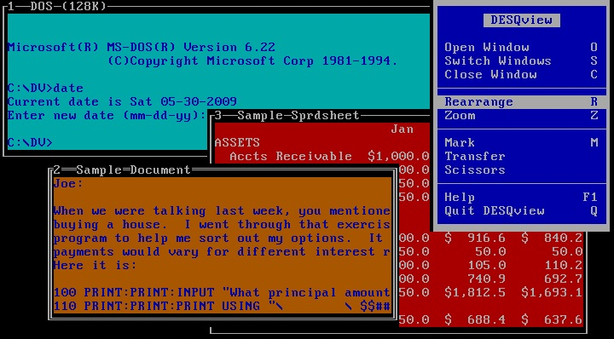
Active Terminate And Stay Resident (TSR)
BRINGING MULTITASKING TO MS-DOS
Shah Antriksh
Semester 5
Information Technology at
Dharmsinh Desai University, Nadiad
Email:antrikshah@hotmail.com

Slide 2
Aim: To build an active TSR which detects an idle keyboard and brings on a screen saver

Slide 3
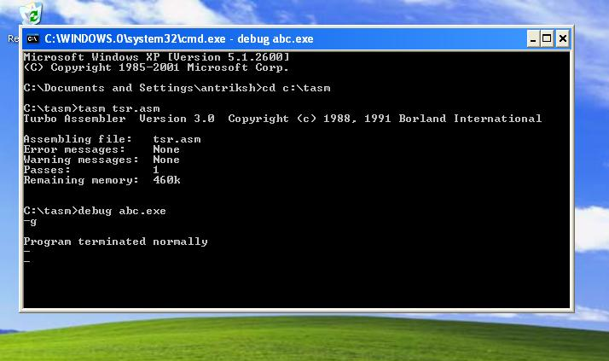

Slide 4
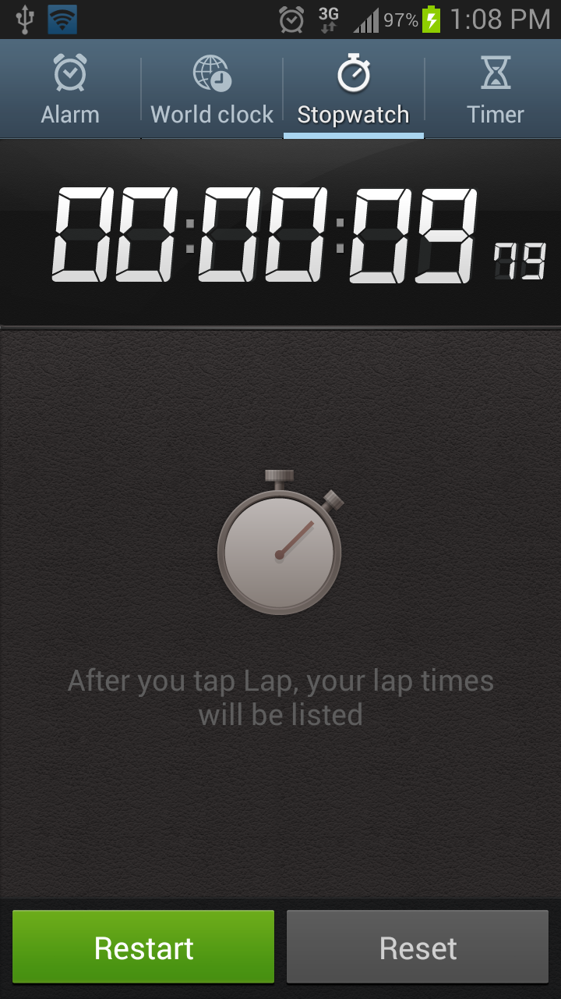

Slide 5
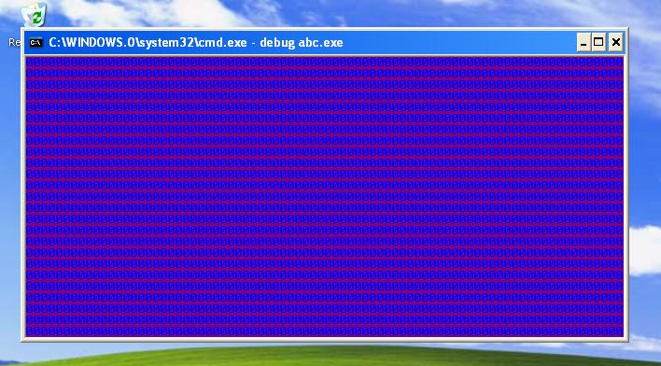
After Remaining idle for roughly 10 seconds the screen saver! Pops up

Slide 6
Acknowledgment
I would like to express my deepest gratitude to my advisor, Prof. Rajendra Chhajed sir, for his support and guidance throughout the project. His continued support has been the only reason for this successful project completion.
I would also like to extend my deepest gratitude to my family. Without their encouragement, I would not have had a chance to complete the project.
I would also like to acknowledge members of DDU Connect group for reminding me “Engineer can get anything done at anytime.”

Slide 7
Brief Overview
MS-DOS – Single User Single Task system.
Multitasking for Printing (print.com)
Borlands Sidekick

Slide 8
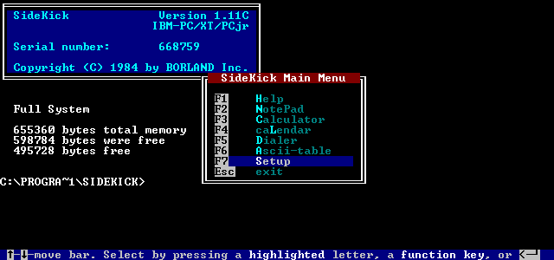
Borlands Sidekick Program
Courtsey -http://en.wikipedia.org/wiki/SideKick

Slide 9
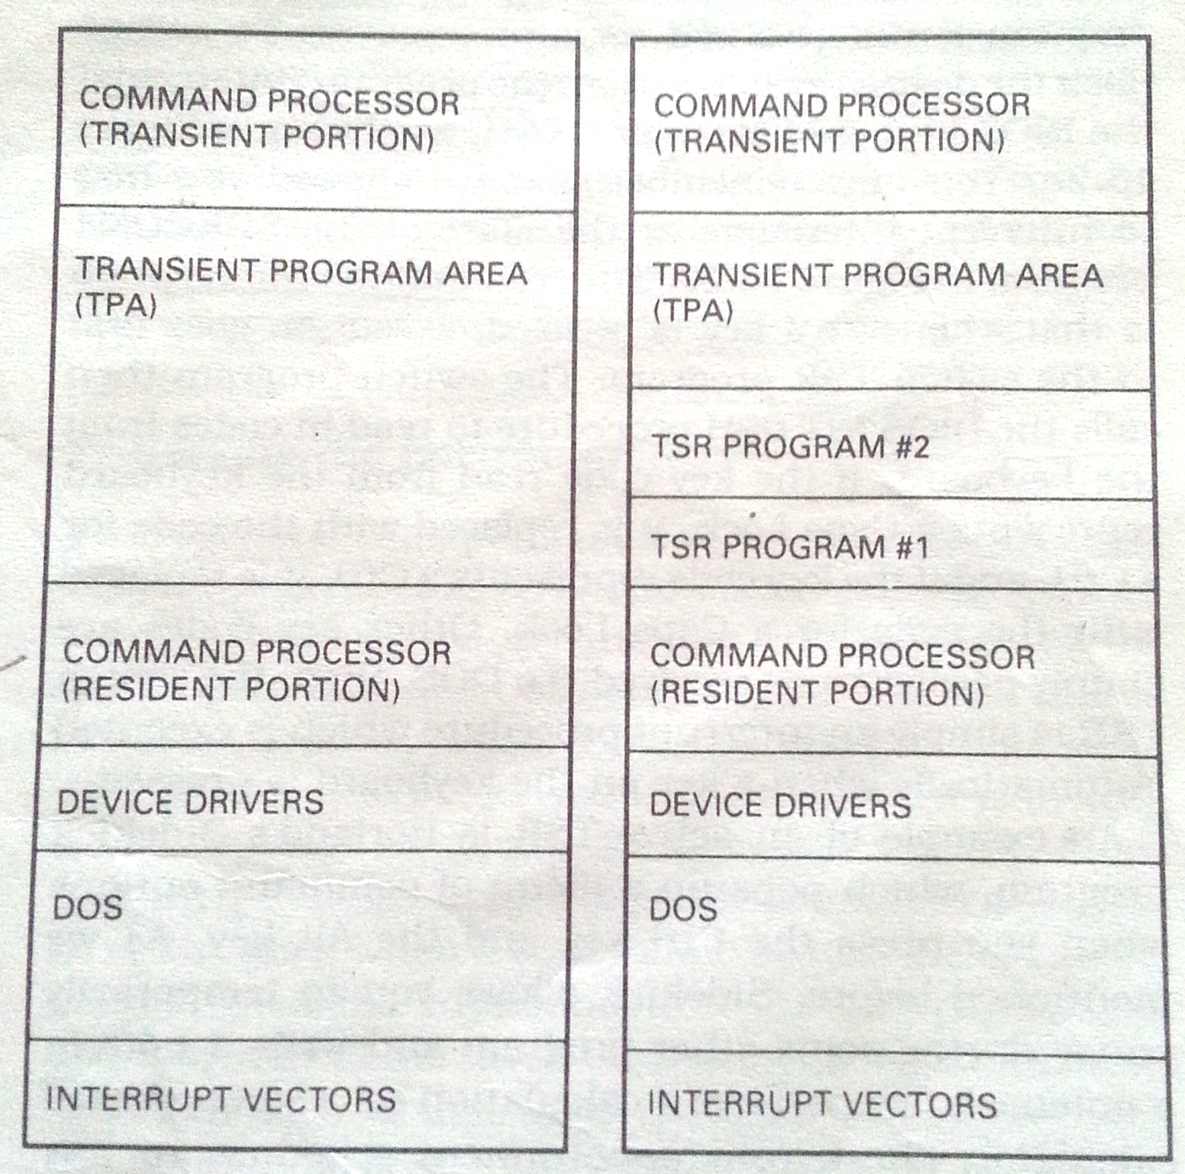
TSR
FIRST 640 Kbytes of RAM

Slide 10
TSR divided into two categories
Passive TSR and Active TSR

Slide 11
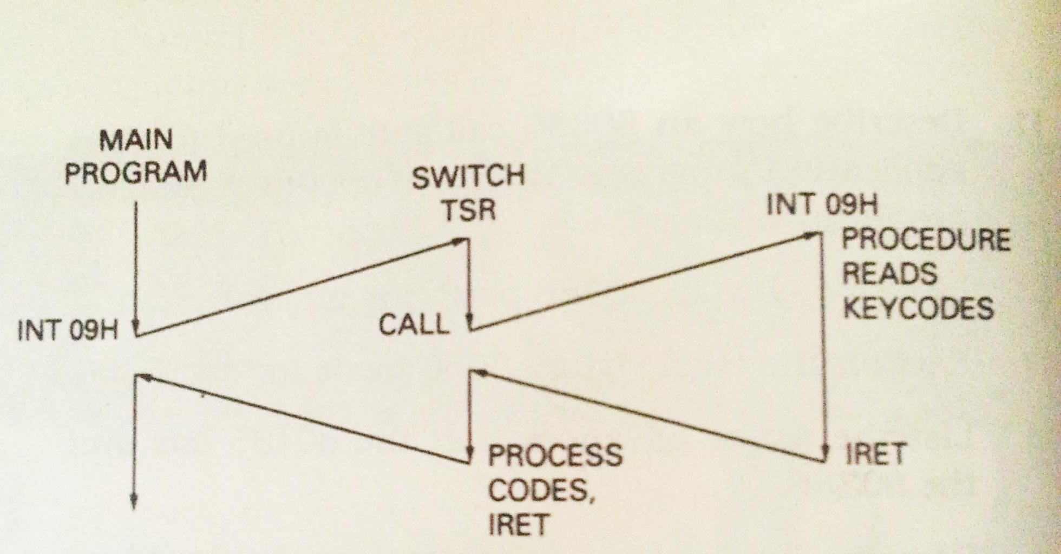
Passive TSR
A passive TSR is one that activates in response to an explicit call from an executing application program.

Slide 12
INT 09 KEYBOARD INTERRUPT
“This hardware-generated interrupt (IRQ 1) is executed upon each press and release of a key. The ROM-BIOS code interprets the keystroke, storing values into the keyboard buffer at 0040:001e. It also handles the special cases of the PrtSc, SysReq, Ctrl+Alt+Del, Ctrl+NumLock (or Pause) keys, and tracks the status of the shift and case-lock keys.”
Source:http://webpages.charter.net/danrollins/techhelp/0106.HTM

Slide 13
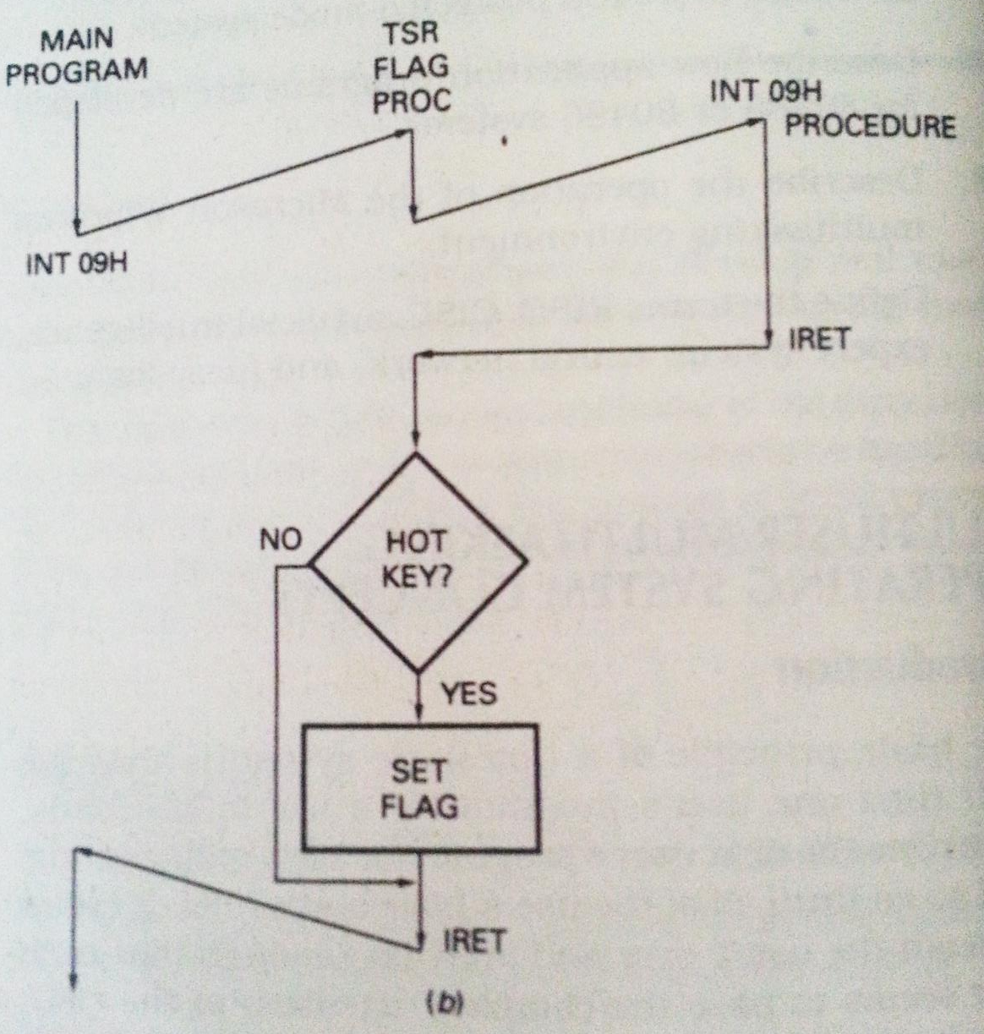
Active TSR
An active TSR is one that responds to a hardware interrupt or one that a hardware interrupt calls.

Slide 14
INT 08 TIMER INTERRUPT
This hardware-generated interrupt (IRQ 0) is executed upon each tick of the PC's real-time clock. The clock ticks every 55ms, or about 18.2 ticks per second. It updates system time and date.
The ROM-BIOS (default) code for this interrupt updates the clock values at 0:046c. It also turns off the diskette drive motors after about 2 seconds without read/write activity.
If you want to use this interrupt for custom timer-keyed activities (as with a TSR program) you must be sure to include the code that tells the system when the interrupt is finished.
Source:http://webpages.charter.net/danrollins/techhelp/0105.HTM

Slide 15
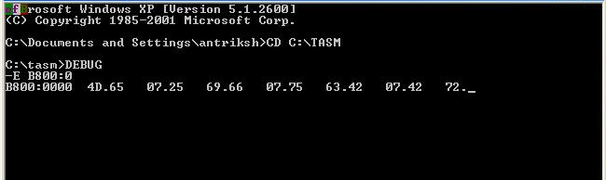
VIDEO MEMORY @B800
The screen is a grid of addressable location. The system has video display area or buffer. The area begins at B000[0]H and supports 4k bytes of memory.
2k for the character
2k for attribute

Slide 16
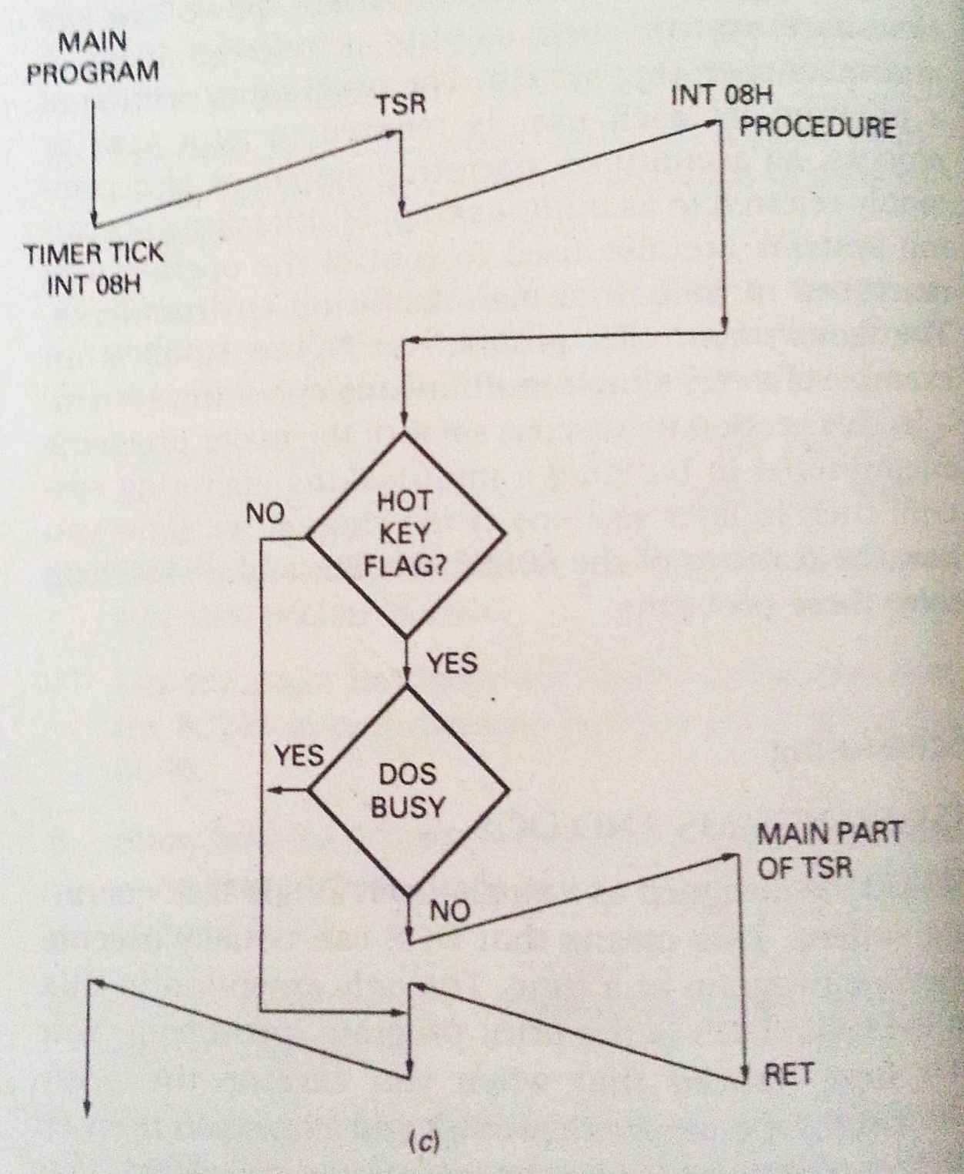
COMPLETE FLOWCHART
Set sophamore 0

Slide 17
ASSEMBLY CODE

Slide 18
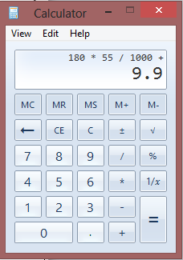
Variable Iniatialisation
START : JMP BEGIN
TIMER_IP DW ?
TIMER_CS DW ?
KB_IP DW ?
KB_CS DW ?
FLAG DB 0
CNT DB 180
BUFFER DW 2000 DUP(0)

Slide 19
INSTALL PORTION
BEGIN:
MOV AX,CS
MOV DS,AX
MOV ES,AX
MOV AH,35H
MOV AL,08H
INT 21H
MOV TIMER_IP,BX
MOV TIMER_CS,ES
MOV AH,35H
MOV AL,09H
INT 21H
MOV KB_IP,BX
MOV KB_CS,ES
MOV AH,25H
MOV AL,08H
MOV DX,OFFSET TIMER
INT 21H
MOV AH,25H
MOV AL,09H
MOV DX,OFFSET KB
INT 21H
MOV AH,31H
MOV DX,OFFSET BEGIN
SHR DX,04h
INC DX
INT 21H
CODE ENDS

Slide 20
INT 08 timer PORTION
TIMER:
PUSH AX
PUSH BX
PUSH CX
PUSH DX
PUSH SI
PUSH DI
PUSH DS
PUSH ES
MOV AX,CS
MOV DS,AX
MOV ES,AX
CMP FLAG,00H
Jnz TIMER_END
DEC CNT
Jnz TIMER_END

Slide 21
INT 08 timer PORTION
CLD
MOV AX,0B800H
MOV DS,AX
MOV SI,0000H
MOV DI,OFFSET BUFFER
MOV CX,2000
REP MOVSW
MOV AX,0B800H
MOV ES,AX
MOV DI,0000H
MOV AL,48
MOV AH,89
MOV CX,2000
REP STOSW
MOV CS:FLAG,01H

Slide 22
INT 08 timer PORTION
TIMER_END:
POP ES
POP DS
POP DI
POP SI
POP DX
POP CX
POP BX
POP AX
JMP DWORD PTR CS:TIMER_CS

Slide 23
INT 09 Keyboard PORTION
KB:
PUSH AX
PUSH BX
PUSH CX
PUSH DX
PUSH SI
PUSH DI
PUSH DS
PUSH ES
MOV AX,CS
MOV DS,AX
MOV ES,AX
MOV CNT,180
CMP FLAG,01
JNz KB_END

Slide 24
INT 09 Keyboard PORTION
CLD
MOV AX,0B800H
MOV ES,AX
MOV SI,OFFSET BUFFER
MOV DI,0000H
MOV CX,2000
REP MOVSW
MOV FLAG,00H

Slide 25
INT 09 Keyboard PORTION
KB_END :
POP ES
POP DS
POP DI
POP SI
POP DX
POP CX
POP BX
POP AX
JMP DWORD PTR CS:KB_CS

Slide 28
After Remaining idle for roughly 10 seconds the screen saver! Pops up

Slide 29
Applications
Key Logger
Alarm Clock
Pop Up Reminders
Screensaver
Virus

Slide 30
Bibliography
MICROPROCCESSORS AND INTERFACING PROGRAMMING AND HARDWARE SECOND EDITION BY : DOUGLAS V. HALL
IBM PC ASSEMBLY LANGUAGE AND PROGRAMMING THIRD EDITION BY : PETER ABEL
THE INTEL MICROPROCESSOR ARCHITECTURE, PROGRAMMING, AND INTERFACING FOURTH EDITION BY : BARRY B. BREY

Slide 31
Bibliography
www.webpages.charter.net
cs.smith.edu/~thiebaut/ArtOfAssembly
www.wikipedia.org

Slide 32
THANK YOU Any questions?

